Slide 1


Mad Flyers
CS315 – Project One
Spencer Smith 09/24

Slide 2
Discussion 1
I don’t want a static “num_enemies” variable. I want it to change based on how many enemies are on the screen, that way I can freely change the levels without going in and tweaking the code.
By using get_parent().find_child()…… I am able to search for a specific node, in this case, called “Enemies”. This node contains all of the enemy objects for the level, so by using get_child_count(), I’m able to find the number of enemies on the screen. Now I don’t have to tweak the code every time I change a level.

Slide 3
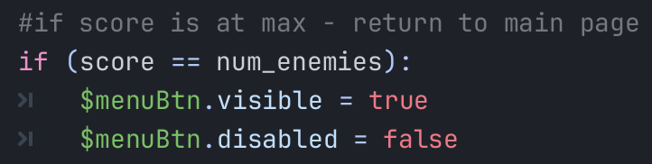
Discussion 1 – Screenshot / image

Slide 4
Discussion 1 – Question
How do I make it so that when there are multiple player fish on the screen, they move independently? Right now, if a new fish is spawned and I fling it, all of the other fish also fling.

Slide 5
Discussion 1
Have a peer / group look through your code and comment on
File structure
Evan said my structure is well organized and he could find where everything was.
Commenting / algorithm planning
The comments make the code easily understandable.
Repetitiveness
There is no unnecessary repetitions. Any repeated lines of code are in functions.
Readability
Very readable. Everything makes sense.
Succinctness
There are some lines of the code that could probably be shortened.

Slide 6
Discussion 1
I learned how to get specific nodes from the node tree within a script, which will allow me to manipulate more aspects of my game.
Next, I’m going to focus on getting the birds to move independently, rather than all moving off of one input.
I’m very happy with my quality of code in terms of readability, variable names, etc., but I’m sure there are more efficient ways to do some of it. I’ll find those ways later on in the project.

Slide 7
Discussion 1 –Reflection
Delete and add your own reflection on:
I gained a better understanding of how export variables work. I’m also more comfortable with referencing other nodes within my code.
I really like that you can use find_child() to get a specific node in a tree, rather than searching for it using an index. I feel like by searching with an index, it would be easy for things to break because the order of nodes in a tree is always subject to change.
One thing I’m not happy with is that every time an enemy is killed, a new player fish is spawned. I need to look into that.
One helpful piece of feedback I received was from Evan about how a specific line of code seemed longer than it needs to be. I just need to do some more research and figure out how to cut it down.
I can give helpful feedback by being specific about what I think should be done differently. Just saying “some of your comments are unnecessary” is not helpful. Instead, ”this comment on this line is bad” would be much more insightful.

Slide 8
Discussion 1 –Self Assessment
Project progress poor acceptable excellent
Variable naming poor acceptable excellent
Debugging / problem solving poor acceptable excellent
Godot exploration poor acceptable excellent
Polish plans poor acceptable excellent

Slide 9
Discussion 2

Slide 10
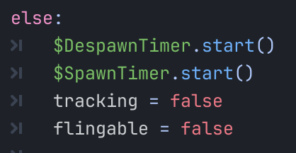
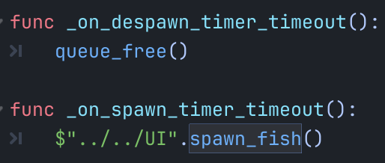
Discussion 2 – Screenshot / Image
This is the solution to the issues I was having. Those issues are noted in the next slide.

Slide 11
Discussion 2 - Question
I needed to refactor how my fish respawner worked.
Originally, it would check if there are still enemies left on the screen. If there were, it would spawn a new fish. There were a couple of problems with this approach.
1. If one fish kills multiple bad guys, it will spawn multiple new fish at once.
2. If the fish hits the barrier, a new fish will not spawn at all.
According to Aidan, I can fix this with a timer that spawns a new fish, regardless of the number of enemies. This stops the two issues I was having because the spawning of the fish is independent of the number of enemies left.

Slide 12
Discussion 2 -
The balance of my game is pretty good, but I think I could add a limit to the number of birds you get per level. As it is, the player gets as many birds that they need to beat the level.
I’m putting a lot of emphasis on how smoothly the birds respawn and despawn. If they didn’t get disabled after they were flung, the player would be able to keep flinging the birds over and over again. After they are flung, a timer is started, and once it ends a new fish is spawned.
For movement, once a bird is flung from its starting position, it’s no longer able to be flung again. You can’t fling another bird until a new one is spawned.

Slide 13
Discussion 2 –Reflection
I’ve been saving everything as its own scene and putting each thing (scenes, assets, scripts, etc.) in its own folder. This makes it much easier to go in and edit a small part of the game without accidentally messing up something else. It’s also much easier to add in and take out new objects because I don’t have to worry about deleting something else’s child.
I think I still have a lot to learn about connecting signals to scripts. Everything I have works, but I think they could work a bit better. My connections could probably be much cleaner than they currently are.

Slide 14
Discussion 2 – Self Asssessment
Bold your self-assessment on the following areas
Project progress poor acceptable excellent
Variable naming poor acceptable excellent
Debugging / problem solving poor acceptable excellent
Godot exploration poor acceptable excellent
Polish plans poor acceptable excellent

Slide 15
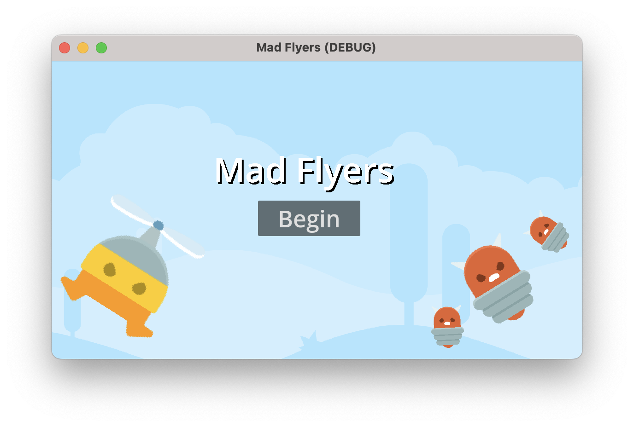
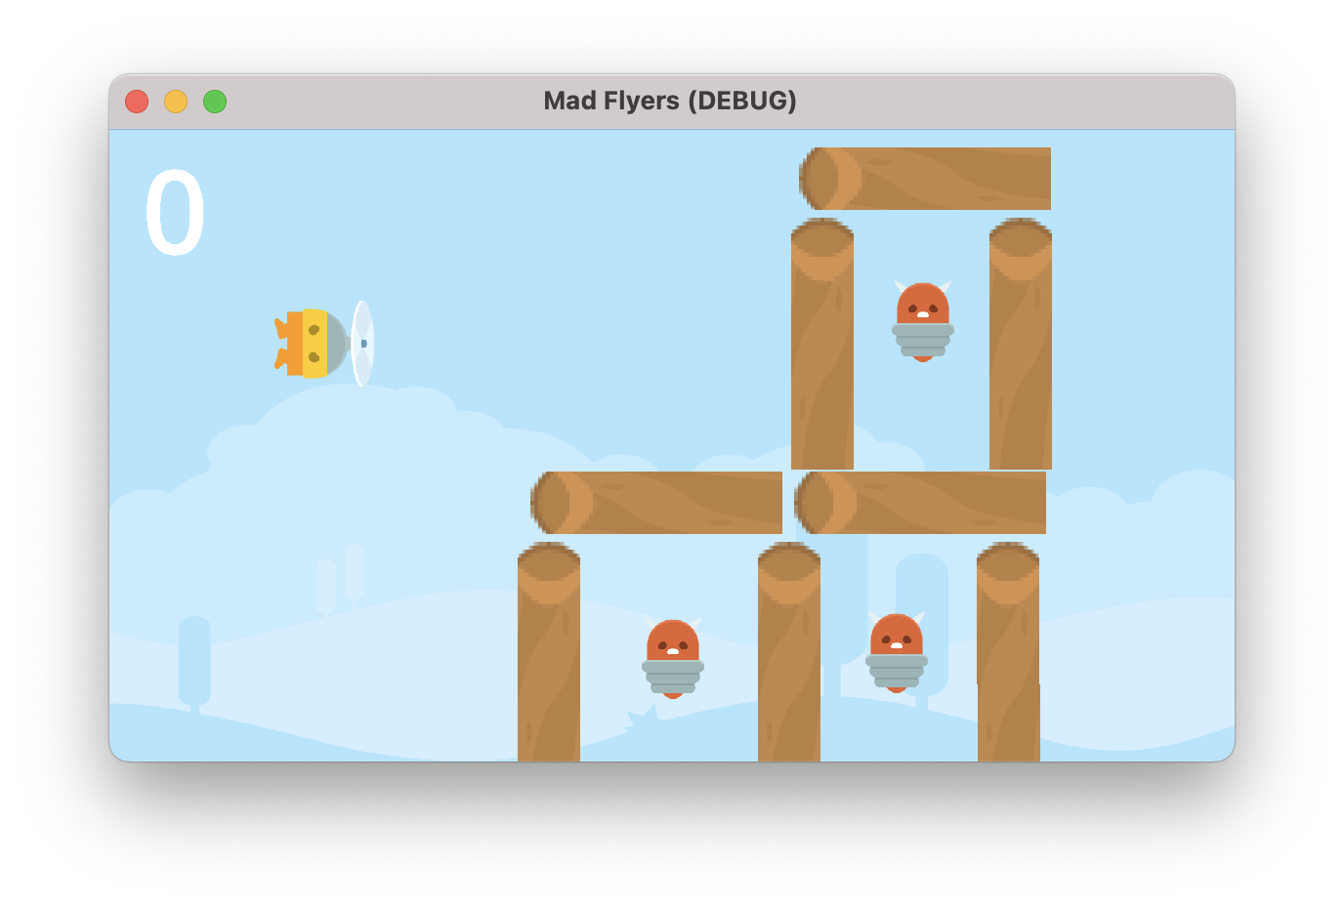
P1 – Final Reflection
Link to video!
Link to GitHub!

Slide 16
P1 – Final Reflection
Delete and add 5-ish bullet points about your project. Cover at least one of each below
Technique
Variables: I’m proud of my variable names, mostly. There are a couple things, like my player and enemy, whose sprite/name changed, but I did not go through and change the variable names in the code. I think that if I started from scratch, with a game that doesn’t already call things birds and fish, this wouldn’t be a talking point of mine.
Debugging: There are no game breaking bugs that the player would notice. The only “errors” I get are warnings about parameters in signal connections that go unused, such as _on_body_entered(body). I’m getting something like “parameter body is unused”. This doesn’t cause any gameplay issues; it just gives a message in the editor. The biggest bug I ran into during development would cause multiple player characters to spawn at the same time, but I found a workaround for that issue.
Aesthetics
Alert: Enemies are red. Red typically means bad. Kill the red bad guys! There’s also noise to indicate that something has happened. The enemy dying or player flinging sounds, for example.
Flow: Beating a level unlocks the next one very clearly. It’s (hopefully) very easy to understand when a level has been beaten.
Major concepts learned
Export Variables: Export variables make instantiating objects very easy. It also makes it easy to keep system resources under control. If I couldn’t instantiate objects, they’d have to be there the whole time, and that will take up unnecessary resources. It’s what lets me spawn new “birds” after the one is sent into the battlefield.
Connecting Signals: This allows one part of my game to talk to another part of my game. For example, when an enemy is killed, the score goes up. That’s done with signals. Same with the despawning of things. When the player is flung, a timer starts. When that timer ends, a signal is sent to the game controller to delete the player that was just flung.

